Slide 1

Machine learning techniques for molecular electrodynamic simulations in real time
Candidate: Siow jia sheng (TCCM)
Relatore : Prof.ssa Paola Belanzoni
Correlatori : Dott. Leonardo Belpassi
Notes:
https://mydissertationeditor.com/dissertation-presentation/

Slide 2
Outline

Slide 3
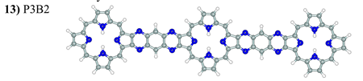
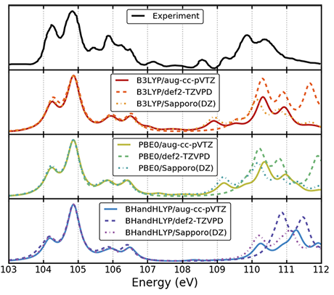
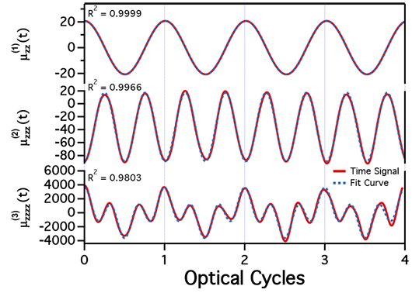
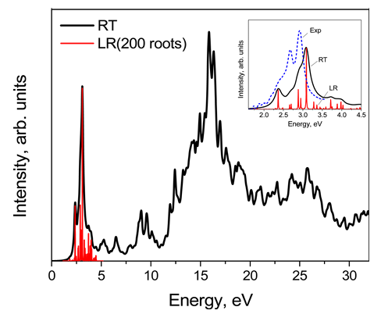
Application of real-time methods
UV / Vis Spectroscopy
X-ray Absorption Spectroscopy
Nonlinear properties
(1)
(2)
(3)
Two-component relativistic RT-TDDFT modelled L_{2,3} absorption edges for SiCl₄
Time-evolution 1st, 2nd, 3^{rd-}order responses BeH modelled with TD-CIS 6-31+G* basis sets
Dipole responses agree with real-time signals and response theory
Simulate linear UV-vis absorption spectrum
much wider spectral range.
Long simulation
Samat Tussupbayeva, Journal of Chemical Theory and Computation 2015 11 (3), 1102-1109
Joseph M. Kasper, Journal of Chemical Theory and Computation 2018 14 (4), 1998-2006
Patrick J. Lestrange, Mark R. Hoffmann, Xiaosong Li, Advances in Quantum Chemistry,Academic Press,Volume 76,2018
Notes:
UV / Vis Spectroscopy
Able to Simulate linear UV-vis absorption spectrum with a dense manifold of states.
Entire energy spectrum is obtained after Fourier transform of the dipole moment.
much wider spectral range. Using long simulation compared to linear response
We have to use relativistiv method because – near core, so we use RT-
X-ray Absorption Spectroscopy
Two-component relativistic RT-TDDFT modelled L_{2,3} absorption edges for SiCl₄ Silicon tetrachloride
two absorption edges, L2 and L3
Two component - excellent balance between the computational cost and theoretical accuracy
Real time can obtain the entire spectrum in X-ray region at once.
Nonlinear properties
We can also model non-linear response of system to EM.
We can see the linear and non-linear properties of Beryllium monohydride
First and second order agree very well between real-time simulation and analytical expression
Some deviation for third order in real-time simulations
Current challenges
The time propagation of the wave-function or the density matrix, is the main challenges
in real-time techniques. This is because the time scales of the propagation ranging
from atto to femto, to even picoseconds. This require large number of steps in the time
propagation

Slide 4
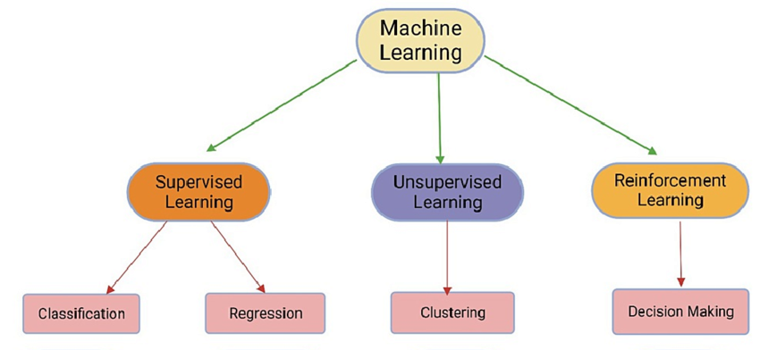


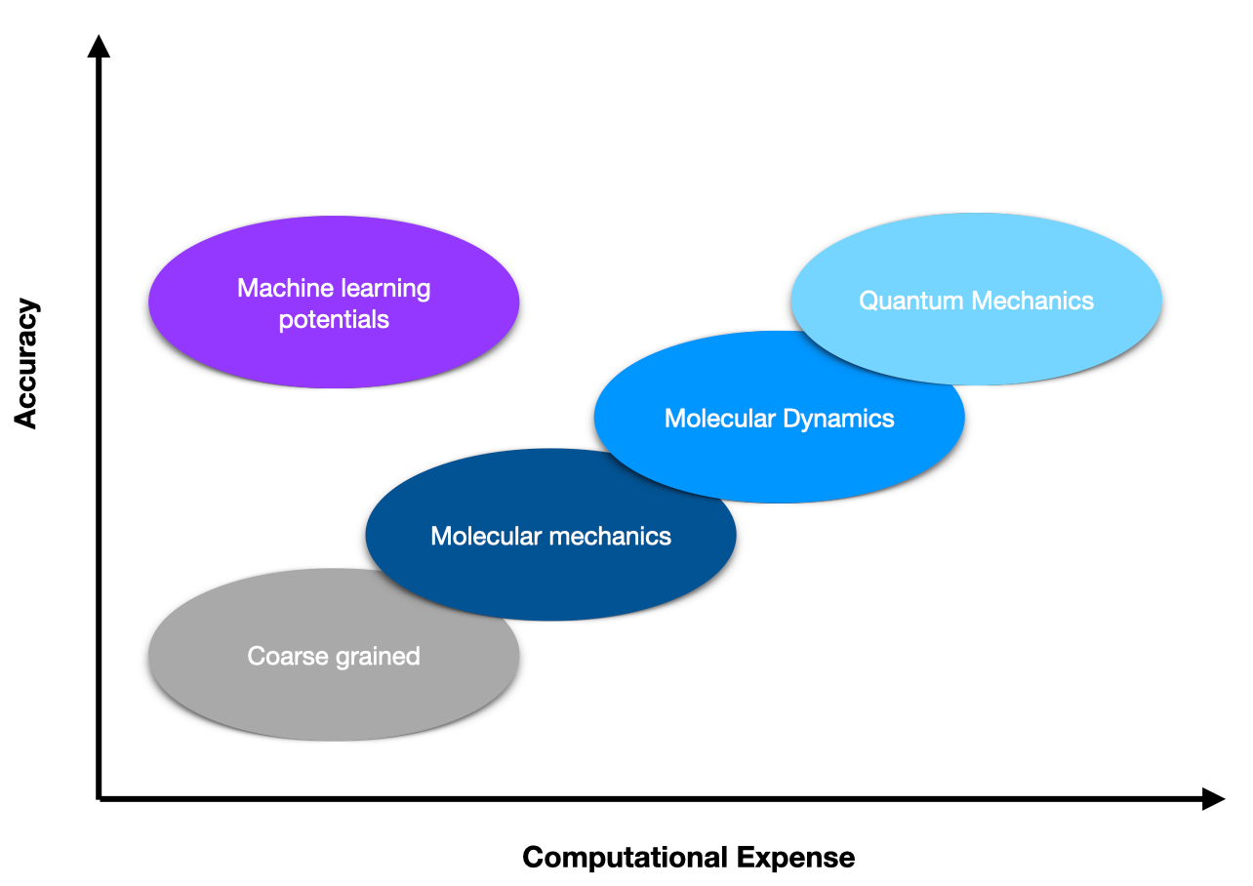
Problem statement
RT simulation
Machine learning
RT simulation + ML
RT-TDHF
Supervised
?
Fock matrix
Density matrix
Notes:
Machine learning
is getting more popular in chemistry in recent years
We have well-developed theories in real-time methods, and recent development of machine learning.
Therefore, it seems
to be a time to investigate the possibility of merging the two branches of science in
order to provide quantum chemists with new tools for research.
computationally intensive explicit time propagation,
has regained motivation in research in recent years due to advances in computing
power and numerical algorithms.
In this work we want to investigate how machine learning can be applied in molecular
electrodynamic simulations.
In particular, we will consider here the simplest ab-initio method for electronic
structure theory based on the mean-field approximation, namely the real time time-
dependent Hartree-Fock (RT-TDHF).
Fock matrix must be iteratively analysed and manipulated, which is the most time-
consuming step. –
we suggest that there
exists a linear relationship between the Fock matrix and the density matrix
Is it possible to we speed up real time
Alternative method using machine learning
In particular we will use supervised learning technique, which use labelled data for prediction

Slide 5
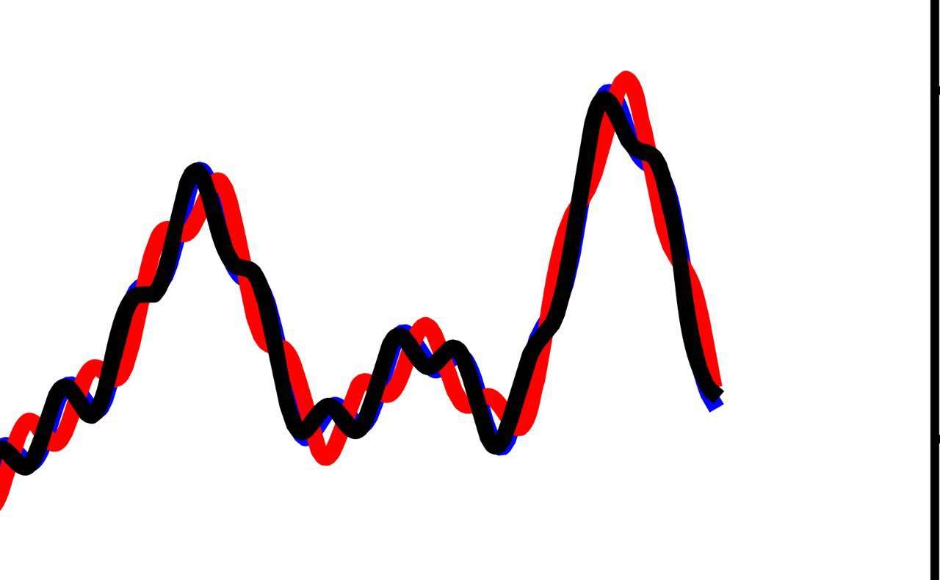
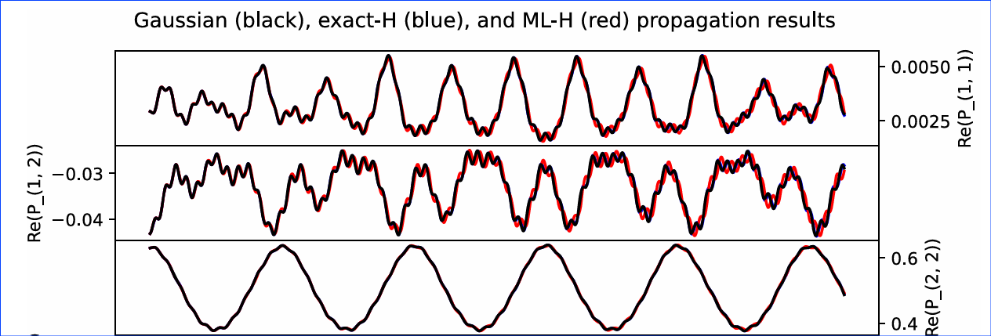

Current studies
Computational method to lean molecular Hamiltonian matrix (H_{2,} HeH+, LiH)
Accurate results – 1000 time steps beyond
Question:
Predicted Fock matrix?
ML methods?
Drawback:
Parameter scaling as basis size K⁴
Storing 2 electron integrals
LiH propagation with no field
Bhat, H.S. - Machine learning a molecular Hamiltonian for predicting electron dynamics.
Notes:
Theory – real –time method
+ a bit machine learning in propagation
Currently – few papers
The only existing papers dealing with machine-learned propagation of the Hartree-Fock Hamiltonian are by Bhat and
his co-workers.
They have used time-dependent density matrices to learn the Hamiltonian, and use learn Hamiltonian for propagation. They have used linear machine learning model.
However, in these papers, they did not
address the quality of the predicted Fock matrix and how accurately it can be compared
to the true matrix.
Furthermore, they did not compare their method with different
machine learning methods.
Drawback:
Parameter scaling as basis size K⁴
Storing 2 electron integrals

Slide 6
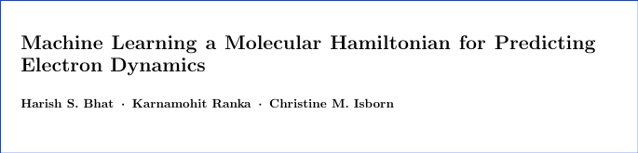
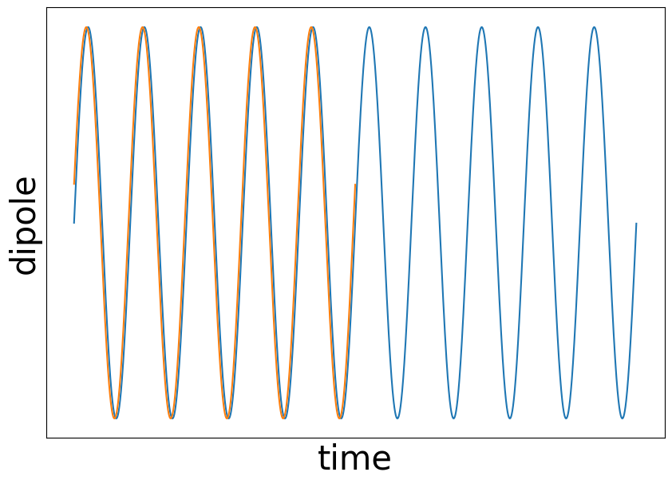
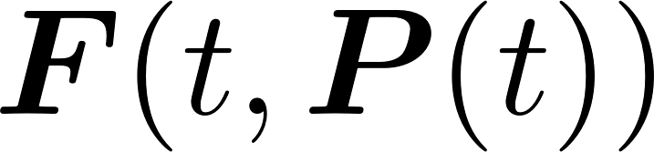
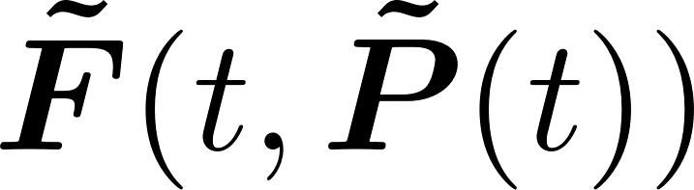
Purpose of the study
Reproduce current studies
Apply to larger molecules
Reduce cost
Use machine learning techniques
ML training
Prediction
Notes:
Reproduce the work of Bhat
Possible using linear regression, deep learning
Hopefully reduce the time for calculation (but fail) We expect that this study will successfully provide us with new
insights for effective electrodynamic simulation using a machine-learned Fock matrix,
and hopefully to reduce computation time allowing for longer propagations, which are
crucial for increasing the accuracy of the derived observables.
n this work, we will investigate the prediction of Fock
matrix using density matrices obtained along the real-time simulation and compare
the performance of different machine learning algorithms.
Due to the limitation of
the existing literature and research approach, this thesis will focus exclusively on the
RT-TDHF scheme since it is the simplest approximation method and we can apply the
findings to other methods, including density functional theory.
We use this
problem as a testbed to develop strategies that can be generalised to other methods in
quantum dynamics, such as the post-Hartree-Fock method and time-dependent density
functional theory.
investigate simple molecular systems with relatively small basis sets since
increasing the hierarchy of basis sets increases the computational resource requirements
This study aims to complement the usual electrodynamic simulation, i.e. to find out
whether it is possible to mix the current method with machine learning analysis instead
of using machine learning as a substitute for the current method. Therefore, we will
use the data generated during time propagation, which are the Fock matrices and the
density matrices generated during propagation, as a complete dataset.

Slide 7
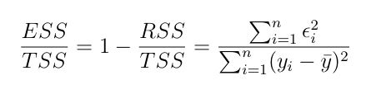
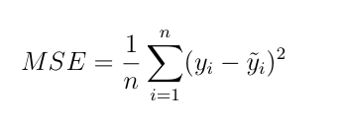
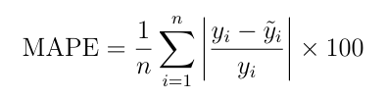
Methodology
1. Obtain training data
2. ML techniques → linear regression, neural network
3. Evaluate results
Performance metrics
Coefficient of determination (R²)
Mean squared error (MSE) / Root mean square error (RMSE)
Mean Absolute Percentage Error (MAPE)
Notes:
Formula
Because we are using a supervised ML technique, need to obtain data.

Slide 8

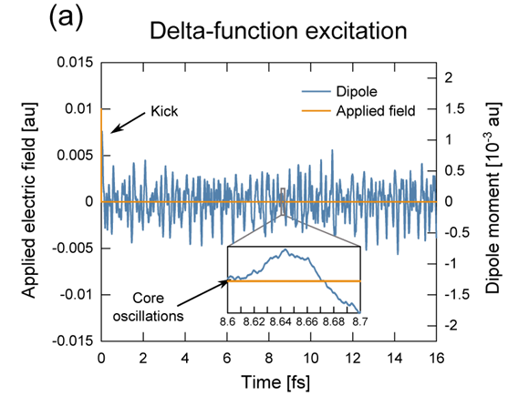
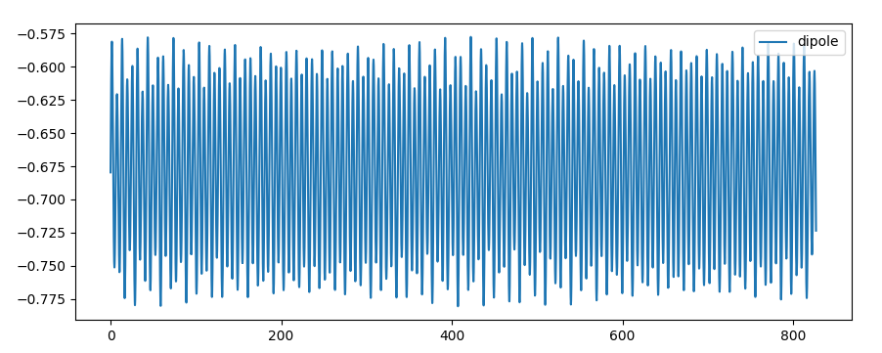
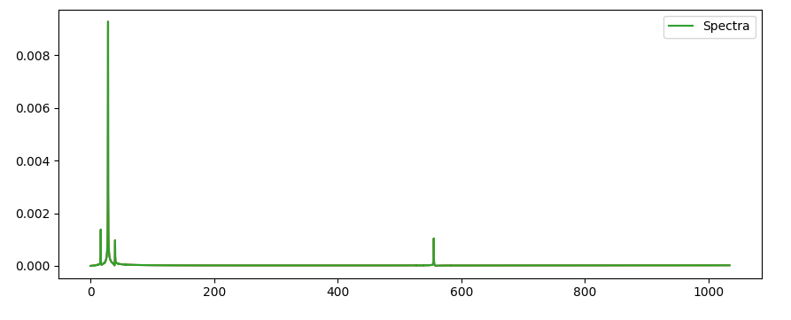

Data collection and analysis
Molecules (H₂, LiH, H₂O)
Density / Fock matrices
Time step
$$P\left(t\right)=U\left(t,t_{0}\right)P\left(t_{0}\right)U^{†}\left(t,t_{0}\right)$$
Density matrix propagation
K. Lopata, B. E. Van Kuiken, M. Khalil, and N. Govind
Journal of Chemical Theory and Computation 2012 8 (9), 3284-3292
[ …| Re(1,2).. | Re(1,3).. …| Im(1,2)…| … ]
Dipole moment
Spectrum
Notes:
Use supervised method machine learning
Particularly LR, NN
Performance metrics
There are many types of machine learning methods. We will use supervised ma-
chine learning methods because we can obtain the data (Fock and density matrices)
during time propagation at each time step.
simple
linear regression method.
which focuses on investigating
the effectiveness of a simple regression model in this framework.
We will also apply
the simple neural network method to investigate whether it is an effective method for
solving our problem.
To check how effective the machine-learned Fock matrix is compared to the
actual value, we introduce different performance metric measurement tools commonly
used in machine learning studies.
Performance metrics (r2, rmse, mape)

Slide 9


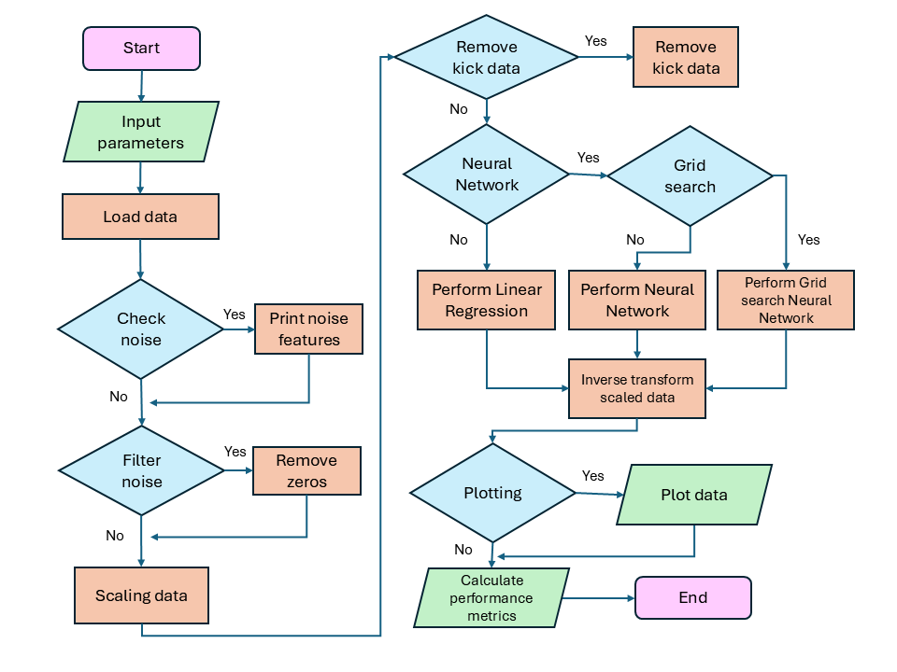




Implementation
Tools
Machine
learning
process
Notes:
Flow chart – show complexity
Libraries
he implementation of
machine learning is done in Python programming language. We used several popular
Python machine learning modules such as scikit-learn, TensorFlow which are available
freely online. Those machine learning modules are easy to use, regularly maintained
by developers, and come with detailed documentation and tutorials.

Slide 10
Research Findings
Outline:
Linear regression:
Effect of different scaling method
Effect of different train-test ratio
Effect of increasing dataset size
Effect of increasing basis size
Effect of changing orientation of LiH molecule
Effect of removing values experienced delta kick function
Effect of removing values identical to zeros
Neural Network:
Effect of changing number of hidden layers
Effect of changing number of neurons
Effect of different types of optimizers
Grid search
Effect of removing zeros
Notes:
Outline
First graph, then we will see what factors that affected it
And we see why the fttting is not perfect

Slide 11
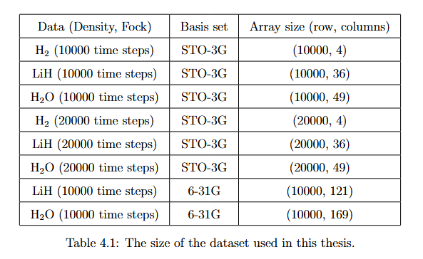


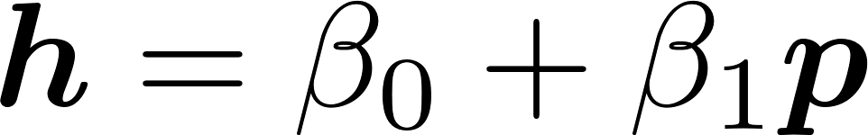
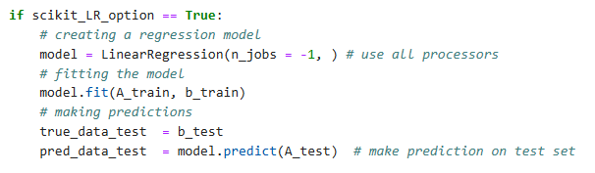
Results and discussions
1. Linear regression
Model
Hamiltonian
density
Notes:
Molecules used are
Data obtained from Propagation using PySCF
Linear regression formula
OLS
This part we will use scikit learn linear regression
Instead of two e ontegral, use parameter

Slide 12
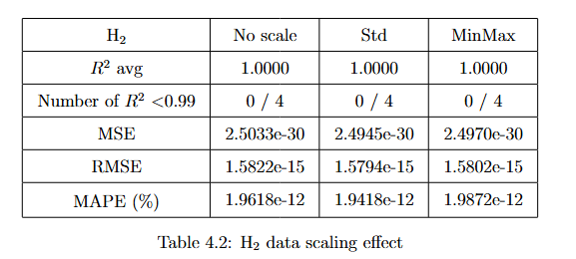

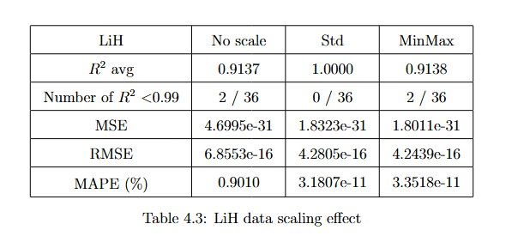

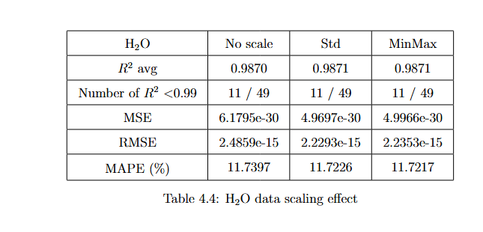
Data scaling
H₂ , LiH, H₂O
STO-3G 10000 time steps
Standard
Min-Max
No scaling
36 Fock matrix elements
Small effect
ML – better with standard range
Notes:
Because our data have different range of values, (negative/positive, decimal values) and we know that in machine learning, scaling data is important. (why?)
Effect not scaling?
Here we will use different data scaling method, which are MinMax scaling, Standard scaling and without scaling.
The results are quite similar in our data sets,
Standard scaler leads to slightly better results, which is better R2 value LiH, because we wants to have values closer to 1, and we have number of R2, which is each features or each density matrix element, there are 36 Fock matrix elements in this case.
Most of 0.99, which is good fit,
But when the data becomes even further larger than H2O, then the scaling effect might be more prominent, because we have more ranges of data.
It is known that many machine algorithms perform better when scaled to
standard range, since many deep algorithms assume normality with a mean of
0 and standard deviation of 1.
Therefore, in the results that come after this, we will the use the standard scaler for machine learning.

Slide 13
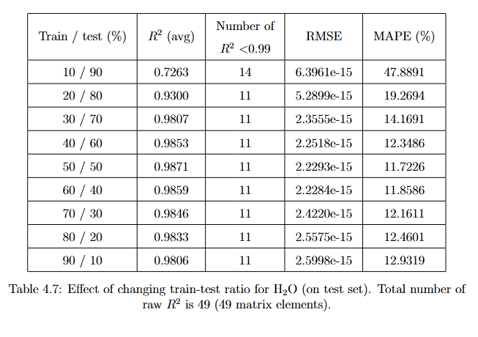
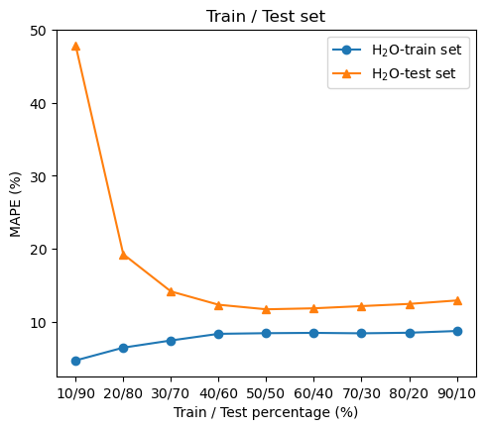
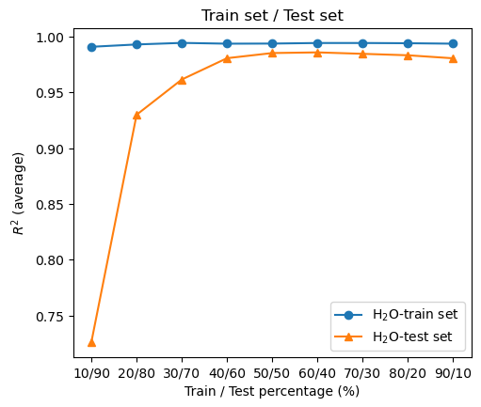
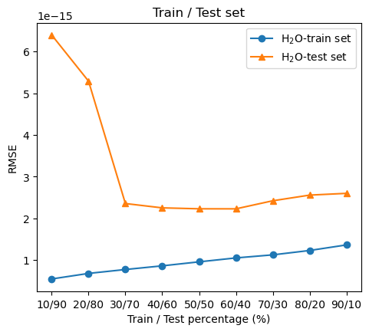
Train-test percentage
H₂O
R²
H₂ , LiH, H₂O
STO-3G 10000 time steps
Here only show H₂O result (more significant)
Prediction accuracy increases when the size of training set increases
H₂O
MAPE
H₂O
RMSE
10% train set data
90% test set data
90% train set data
10% test set data
Notes:
(interpretation explain of graphs)
(for H2 and LiH, the trend remains the same across different train-test ratio, which is accurate such that R2=1, very low MAPE and RMSE)
We have also tested for Hydrogen and LiH , but the data on water molecule is more significant
prediction accuracy increases when the ratio of training set increases
because algorithm has more data to learn, it performs better on the prediction
we should use at least 50% of training data for prediction, prediction converge to stable value
on test set
Table
H₂ and LiH , but the data on water molecule is significant

Slide 14
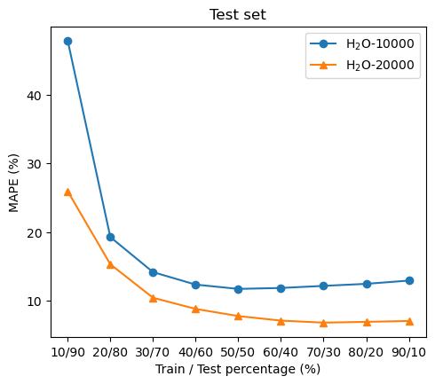
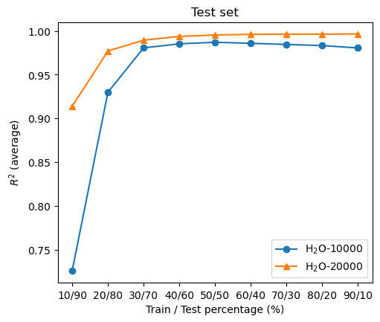
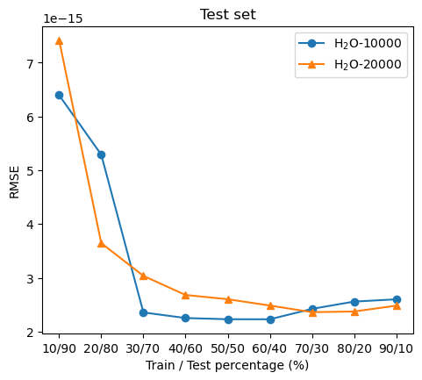
Increasing dataset size
R²
H₂O
STO-3G
10000 / 20000 time steps
10000 → 20000 time steps
MAPE
RMSE
double the training data
longer propagation lowers the inaccuracy
Notes:
prediction accuracy increases when we include more time steps
By including twice
the results of time steps, we include also double the training data in each train-test
ratio, and longer propagation results. We can see that longer propagation lowers the
inaccuracy of prediction
Expected because more data to learn from

Slide 15
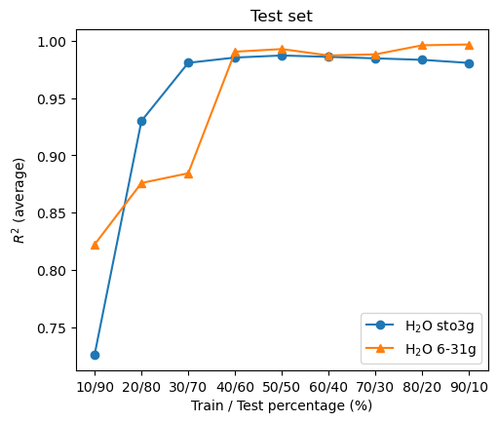
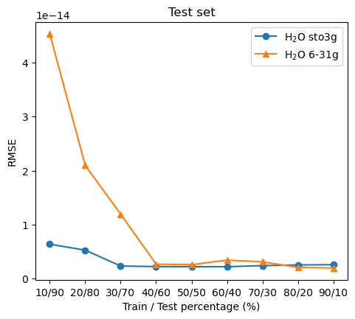
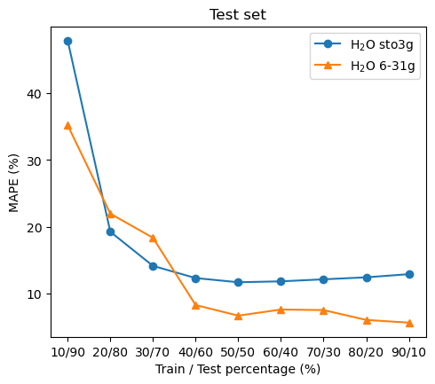
Increasing basis size
R²
H₂O
STO-3G 10000 time steps
STO-3G → 6-31G
49 → 169 Fock matrix elements
RMSE
MAPE
Limitation of method:
aug-cc-pVDZ → 41 × 41,
aug-cc-pVTZ basis → 92 × 92
Notes:
STO-3G, 6-31G
The increase of basis results in the analysis of 49 number of features
increase to 169 number of feature
With the increase of basis size, we expect to see
the prediction more prone to error. However, the study shows the value of R2 remains
similar with increasing size of basis. The MAPE decrease with increase basis size.
This might because basis is not the main factor for error
Limitation of this approach – increase largely for large basis set

Slide 16
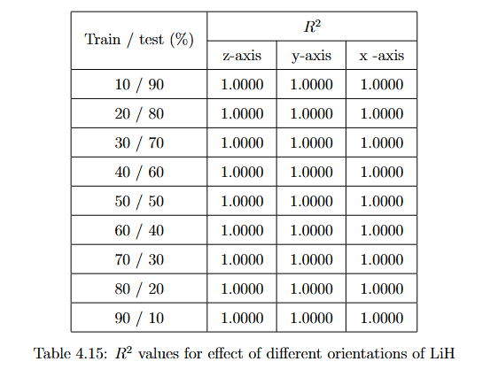
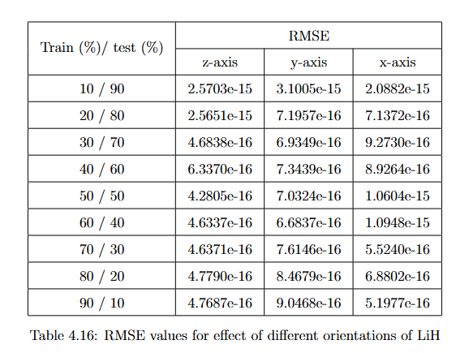
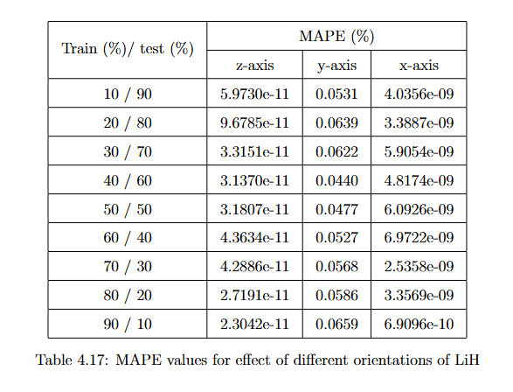
Changing orientation
LiH
STO-3G 10000 time steps (z, y, x direction )
no significant effect and performs good predictions for different orientations
z
field
y
field
x
field
LiH
Notes:
We want to know that if a orientation of a simple molecule can affect the machine learning prediction,
So we propagate the molecules with different orientations to the field, with Pyscf and generated another datasets.
small linear diatomic molecule such as LiH, the changing its alignment of bond axis in
x, y and z axis to the perturbation with respect to the incoming field directed along
the z-axis generally has no effect and performs good predictions

Slide 17
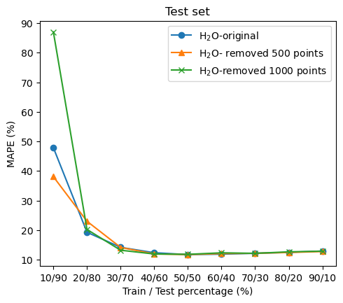
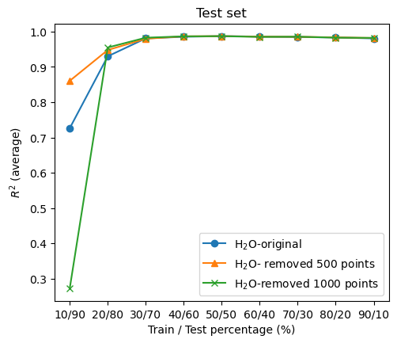
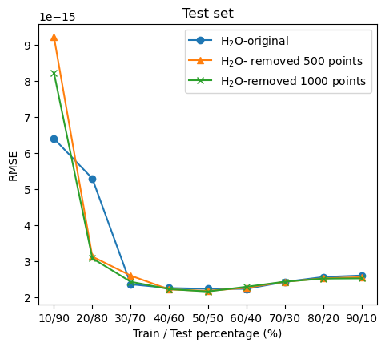
Removing value experienced perturbation LiH /H2O
R²
LiH, H₂O
STO-3G 10000 time steps
when increase the number of training data, initial values effect not significant
might caused by other factors
Dataset
500
values
MAPE
RMSE
1000
values
Time step
Training and testing
Current dataset: H2O STO-3G 10000 time steps
Notes:
LiH – no effect prediction the same whether we remove or not the values
ur data are obtained from real-time TDHF simulation, which use a
time dependent perturbation or delta-kick function. We expect that applying a delta-
kick, means that applying an electric field for a very short time at t = 0, equally
excites all the optically allowed transitions
Thus it is interesting to investigate
such effect on the fitting procedures. One may expect that the very first time steps of
the time evolution are affected by this instantaneous perturbation.
The number of data removed are 0 (remove 0 values), 500 (-500 values) from the first
500 time steps and 1000 (-1000 values) data from the first 1000 time steps
Suspect might caused by other factors (underlying)
. However, our ap-
proach is different, and hence removing data with only two time steps will not affect
the result.
when we increase the number of training data,
the delta kick effect will not be important, and the results converge to the same value
when we remove different number of initial values. This is expected as we include more
training data, the learning is more effective.

Slide 18
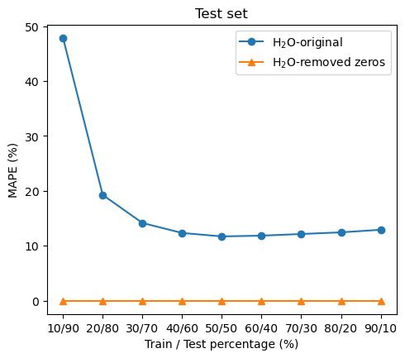
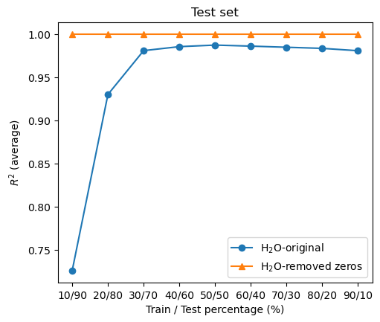
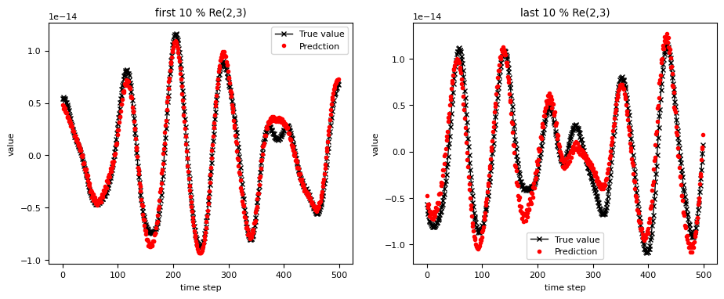
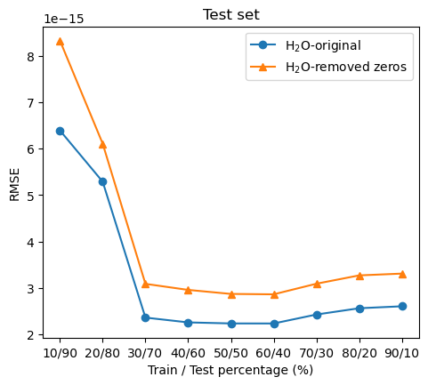
Removing noise
MAPE
R²
H₂ , LiH, H₂O
STO-3G 10000 time steps
Values < 1 × 10⁻¹³
significant increase on the accuracy of the prediction (overall)
Learned on small values
Test set (Re(2,3))
RMSE
Notes:
Re(2,3) and Im(2,3) represents the time series plots of H2O dataset with respect to the 2nd row and 3rd column of real and imaginary part of Fock matrices.
The red dot represents the predicted value Fock matrix elements, and the black cross represents the true value of Fock matrix elements.
The “first” and “last” 10% in the plot label means that we plot the fist 500 data points, and last 500 data points, out of the 5000 data points.

Slide 19
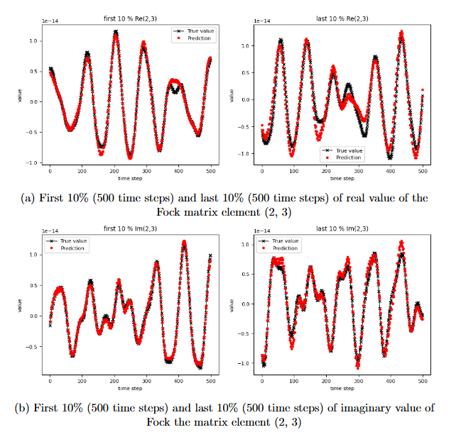
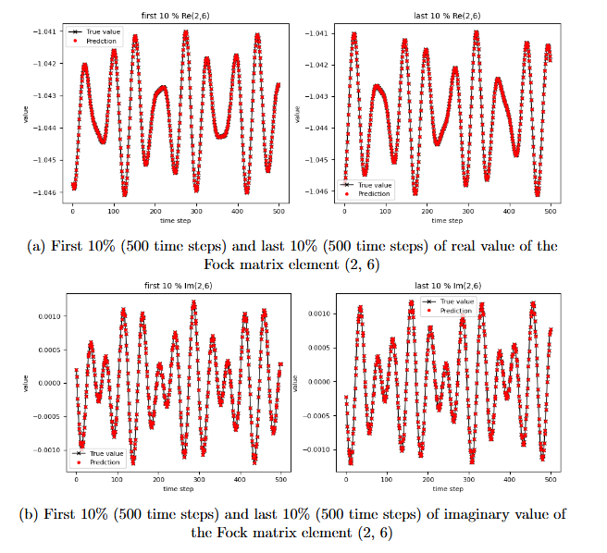
Removing noise
Example of poor predictions
Example of good predictions

Slide 20
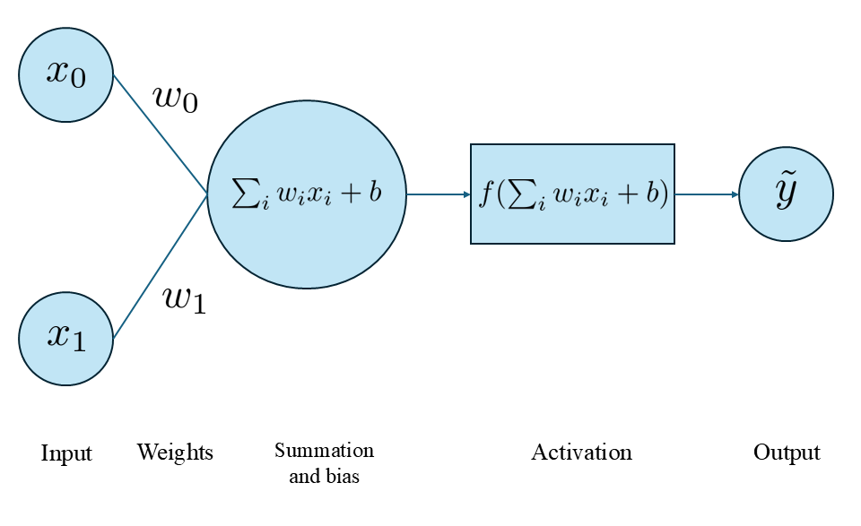
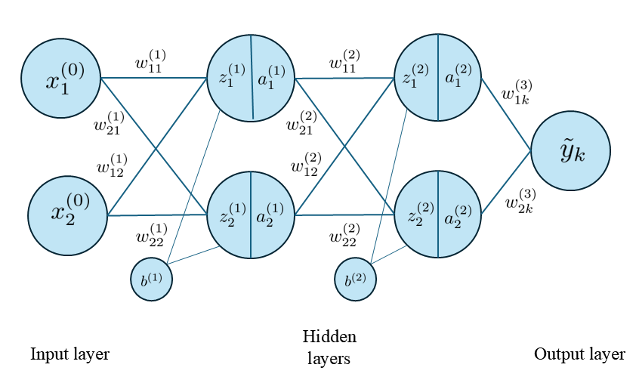
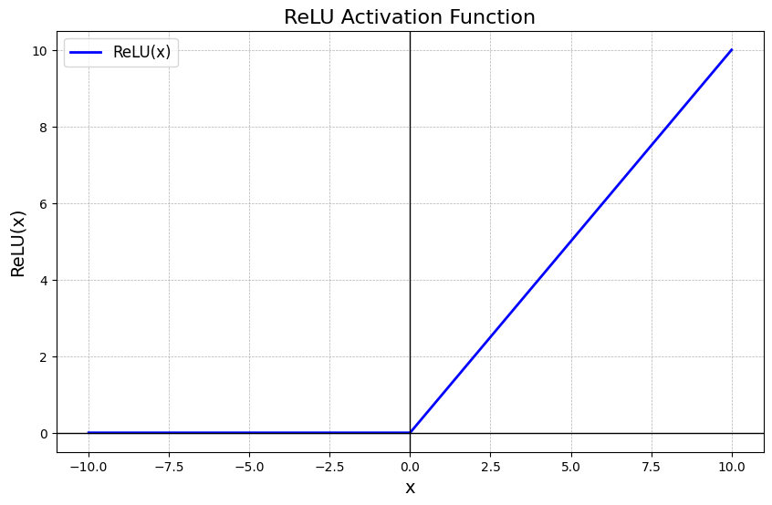
Results and discussions
2. Neural network
Hyperparameters
Neural network
Number of hidden layers
Number of neurons
Optimizers
Notes:
For the hidden layers, we are using ReLU activation function to introduce non-linearity, it is the most poular activation function.

Slide 21




Number of hidden layers
R²
H₂O
STO-3G 10000 time steps
256 neurons each layer
prediction accuracy decreases
Introduce non-linear to linear task
# Hidden layer ≠ accuracy
MAPE
RMSE
Notes:
With an increasing num-
ber of layers, we notice that the prediction accuracy decreases.
This is because the data is a linear
regression task, and increasing non-linear layer will decrease the accuracy. Without
hidden layer, the model performs as linear regression. Increasing the number of hidden
layer, does not necessarily increase the prediction accuracy. In the neural network, we
only need hidden layers if the data need to be explained non-linearly.

Slide 22




Number of neurons
R²
H₂O
STO-3G 10000 time steps
1 hidden layer
rule-of-thumb method : 2/3
MAPE
RMSE
Notes:
The number of neurons in the input layer, is
decided by the number of input parameters, similarly in the output layer that decided
by number of output parameters
However, the number of neurons in the hidden layer
is not fixed. Using few neurons in the hidden layers, will result underfitting, while too
many neurons in the hidden layers will result in overfitting.
Generally, we can see that the best
number of neurons in the one hidden layer are around 32 in this case. This is consistent
with the rule-of-thumb method that are used for determining the number of neurons in
the hidden nodes.[62] The number of neurons in one hidden layer are 2/3

Slide 23




Types of optimizers
R²
H₂O
STO-3G 10000 time steps
1 hidden layer, 256 neurons
Stochastic Gradient Descent (SGD) optimizer
Kumar G, “Optimizing Neural Networks”
Adam optimizer
combines two techniques compared to SGD (momentum, adaptive learning rates)
MAPE
RMSE
Adam > SGD
Notes:
Overall, using Adam optimizer results in better prediction than SGD optimizer. We
can see that Adam optimizer works effectively in small number of training data, while
SGD only rise in the prediction accuracy with increasing training data
his might
because Adam generally converges faster and more reliable than SGD, and is preferred
choice due to its efficiency, while SGD may require more training iterations.
This
is because Adam combines two techniques compared to SGD, which are momentum
and adaptive learning rates. Momentum can speeds up the training by accelerating
gradients in the right directions, intuitively can say as rolling ball down the hill with
increasing momentum.[63] The adaptive learning rates adapts the learning rate for each
parameter for faster convergence, compared to SGD only use a fixed learning rate.

Slide 24



Grid search
H₂O
STO-3G 10000 time steps
Changing hyperparameters:
Hidden layers →[ 0, 1, 2 ]
Neurons → [32, 64, 128, 256]
Optimizer → [ adam, sgd ]
Good implementation even without grid search (understanding data)
Time consuming
Suitable for many hyperparameter values
Notes:
We have defined the dictionary of hyperparameters of 0, 1 and 2 hidden
layers, adam or sgd optimizers, and with 32, 64, 128 , 256 number of neurons.
ompared to the guessed default hyperparameters we have defined, we
can say that we have good implementation of the three hyperparameters (number of
hidden layers, number of neurons, types of optimizers) without using the grid search.
This shows that learning the neural network theory and understanding the data we
are working is important, to save time for tuning.
The process of
completing the grid search takes time, and once we have obtained the best result,
we are not sure whether a change in parameters would give us better result.

Slide 25



Removing zeros neural network
R²
H₂O
STO-3G 10000 time steps
1 layer, neuron, adam
After
Before
Same procedure as linear regression method
Values < 1 × 10⁻¹³
MAPE
RMSE
Improve accuracy when removed zeros
Before
Before
After
After
Notes:
the procedure of removing the features that are zeros is same
as in the linear regression method, which is finding out the absolute and mean of the
values for density and Fock matrices across time series that are less than 1 × 10−13
We can see that the prediction accuracy rise significantly, shows that the noise will
also directly affect the training of the model of neural network. This means that the
presence of noise that caused the model to learn on wrong values and perform badly.

Slide 26



Comparing result linear and NN
H₂O
STO-3G 10000 time steps
Real
Imaginary
Notes:
Parameters of NN?
By looking at the plots similar, both prediction results are good.
We have to rely on the numerical values
We can see that linear regression method is better,
Because NN has many factors that affect the accuracy

Slide 27
Perspectives
Optimize our code, such as running the neural network on a GPU
More effective methods for large data (basis size, data size)
Next step -
learned Fock matrix to
simulate the electron dynamics
Limitation of method:
aug-cc-pVDZ → 41 × 41,
aug-cc-pVTZ basis → 92 × 92
ML training
Prediction
Notes:
are ways to optimise our code, such as running the neural network on a GPU
e expect to investigate to apply the scheme worked out here
to larger molecular system with extended basis set,
and develop more effective machine
learning methods when dealing with data that require large memory.
Instead of predicting one by one
se other regression methods such as ridge regression models, to test if there is an
increase of prediction accuracy.
e aim to incorporate the machine learning
algorithms into the propagation code to execute the machine learning in real-time, in-
stead of extracting out the density and Fock matrices independently. The next step for
future work will be using this learned Fock matrix for the electron density evolution,
because we are interested in knowing how good the predicted Fock matrix in the actual
real-time propagation scheme.
Next step -
learned Fock matrix to
simulate the electron dynamics in the presence or absence of an applied electric field, as
shown in the previous literature.
This can be done by reconstructing the predicted forck matix elements, back into its matrix form

Slide 28
Conclusions
Investigated factors that affect the accuracy
Quality of the data, which must be inspected
Neural network best combination of hyperparameters.
Choose the simplest algorithm
Not necessarily reduce the computation time, but it is possible to use an alternative method
Notes:
This thesis shows that the use of machine learn-
ing methods such as linear regression and neural network can be promising to learn
and predict the Fock matrix given the time series of density matrices generated in a
real-time simulation.
investigated the factors that affect the accuracy
of the training and prediction, thus completing the previous literature works by Bhat
and coworkers [1, 2, 3]. Once the factors that affect the accuracy of the prediction are identified, this
machine-learned Fock matrix can be effectively used for propagation instead of the
exact Hamiltonian, which is costly.
In general, machine learning is good at making predictions, and
when more training data is included, the prediction accuracy increases. The presence
of noise in the dataset is the main factor that affects the accuracy of prediction
This work shows that the machine learning can potentially be a useful tool to be
applyed in the electrodynamics simulations.
Linear regression method is one of the
earliest form of machine learning, it is easy to use and is effective in most applications.
limitation of using machine learning is the quality of the data, which
has to be inspected, requiring pre-processing of data if necessary.
Besides, in the case
of neural network, we do not know the factor and underlying data patterns that give
us the best combination of hyperparameters.
We also analysed the time complexity of the linear
regression and neural network, which shows that it can potentially reduce the cost
of computation compared to the usual evaluation of the two-electron integral.
different combinations of hyperparameters in the neural network also affects the
accuracy of the prediction. Therefore, the data set should be carefully analysed before
performing machine learning to increase the accuracy.
hus, if the simplest algorithm can perform the prediction
accurately, we do not need to apply for more complex algorithms that consume larger
resources.
Conclusion
Not necessarily reduce the computation time, but it is possible to use an alternative method
Identified the factors
Prove the work of Bhat can be done

Slide 29
Acknowledgement
Special thanks to:
Dott. Leonardo Belpassi
Prof.ssa Paola Belanzoni
Thank you for your attention
Notes:
Supervisor, friends

Slide 30
Appendix – tables data

